Slide 1
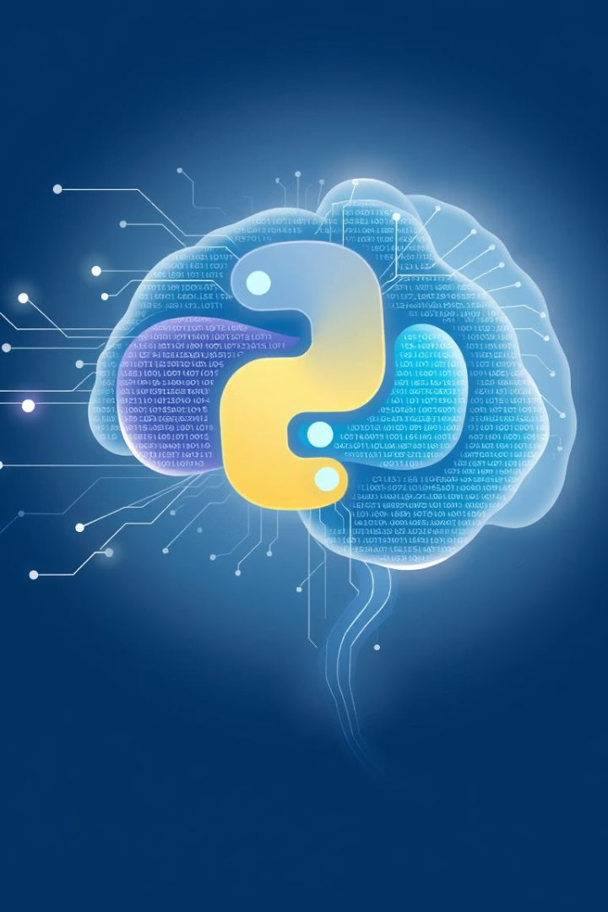
Python Course With Basic Of
Machine Learning

Slide 2
Introduction to Python
Variables
Data Types
Input/Output
Learn how to declare and use variables effectively in your programs.
Understand different data types such as int, float, str, and bool.
Master taking user input and displaying results. This fundamental skill allows for interactive programs.
Integer(int): a=22
Decimal Numbers(float) : a=3.14
String(str): a=“Python”
Boolean(bool): a=True
List : a=[‘a’,’b’,’c’]
Tuple: a=(1,2)
Dictionary: a={1:’name’}
Print(type(a)// to check data types
name = "Aditya“
age = 22
user_input = input("Enter your name: ")
print("Hello", user_input)
Variable names must start with a letter (a–z, A–Z) or an underscore (_).
The rest of the name can include letters, numbers, or underscores.
Variable names are case-sensitive.
No special characters or spaces allowed.
Do not use Python keywords as variable names.

Slide 3
Python Operator
Assignment Operators (update variables)
= : Assign (x = 5)
+= : Add and assign (x += 3 means x = x + 3)
-= : Subtract and assign (x -= 2)
*= : Multiply and assign (x *= 4)
/= : Divide and assign (x /= 2)
Arithmetic Operators (for math)
+ : Add (5 + 3 = 8)
- : Subtract (5 - 2 = 3)
* : Multiply (4 * 2 = 8)
/ : Divide (8 / 2 = 4.0)
// : Floor division (quotient without decimal) (7 // 2 = 3)
% : Modulus (remainder) (7 % 2 = 1)
** : Power (exponent) (2 ** 3 = 8)
Logical Operators (combine conditions)
and : Both true (True and False → False)
or : Either true (True or False → True)
not : Opposite (not True → False)
Membership Operators (check in sequences)
in : Exists in ('a' in 'cat' → True)
not in : Does not exist ('b' not in 'cat' → True)
print("Welcome to Rock, Paper, Scissors!")
computer_choice = "rock" # fixed choice
user_choice = input("Choose rock, paper, or scissors: ").lower()
if user_choice == computer_choice:
print("It's a tie!")
elif user_choice == "paper":
print("You win!") # paper beats rock
elif user_choice == "scissors":
print("You lose!") # scissors lose to rock
else:
print("Invalid choice!")
Comparison Operators (compare values)
== : Equal (5 == 5 → True)
!= : Not equal (5 != 3 → True)
> : Greater than (6 > 4 → True)
< : Less than (3 < 5 → True)
>= : Greater or equal (5 >= 5 → True)
<= : Less or equal (2 <= 3 → True)

Slide 4
Control Structures
1
If-Else Statements
2
Loops (for & while)
3
Mini Game: Guess the Number
Control program flow using conditional statements. This allows your code to make decisions based on specific criteria.
Repeat actions efficiently using 'for' and 'while' loops. Loops are essential for automating repetitive tasks.
Apply control structures in a fun "Guess the Number" game. This practical exercise reinforces your understanding of conditionals and loops.
age = int(input("Enter your age: "))
if age >= 18:
print("Adult")
else:
print("Minor")
for num in range(1, 11):
if num % 2 != 0:
continue # Skip odd numbers
print(num)
# Used to repeat something for a fixed number of times or over a collection
for i in range(5):
print("Iteration", i)
# Repeats the block as long as a condition is True.
count = 1
while count <= 5:
print(count)
count += 1
Break Statement
Stops the loop immediately.
if i == 5:
break
Continue Statement
Skips the current loop iteration and moves to the next one.
if i == 3:
continue
1
If- Elif Else Statements
Control program flow using conditional statements. This allows your code to make decisions based on specific criteria.
age = int(input("Enter your age: "))
if age >= 18:
print("Adult")
Elif age<18:
Print(‘minor’)
else:
print(“Invalid Input")

Slide 5
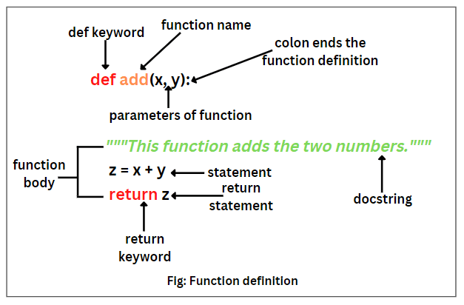


Functions
Defining Functions
Create reusable blocks of code. Functions help organize your programs and avoid repetition.
def greet(name):
return f"Hello, {name}!"print(greet("Aditya"))
Function Arguments
Learn to use parameters and return values. This enables functions to process data and provide results.
def add(a, b): return a + bprint(add(3, 5))

Slide 6
Functions
def calculator(a, b, operation):
if operation == "add":
return a + b
elif operation == "sub":
return a - b
elif operation == "mul":
return a * b
elif operation == "div":
return a / b
else:
return "Invalid Operation"
print(calculator(10, 5, "add")) # 15
Functions with Parameters
Functions that take inputs (arguments)
def greet(name): print("Hello, " + name)
Functions with Return Values
Functions that return a value using return
def add(a, b): return a + b
Functions with Default Parameters
Parameters with default values if no argument is passed
def greet(name="Guest"): print("Hello, " + name)
Recursive Functions
Functions that call themselves
def factorial(n): if n == 1: return 1 else: return n * factorial(n - 1)
def quiz():
score = 0
answer = input("Q1. What is the capital of India? ").lower()
if answer == "delhi":
score += 1
answer = input("Q2. What is 5 + 3? ")
if answer == "8":
score += 1
answer = input("Q3. Python is compiled or interpreted? ").lower()
if answer == "interpreted":
score += 1
print("Your score:", score)
quiz()

Slide 7
Data Structures
Lists & Tuples
Dictionaries & Sets
Mini Tasks
Focuses on lists for ordered, mutable collections and tuples for immutable collections. These are fundamental for organizing data.
Introduces dictionaries for key-value pairs and sets for unique, unordered collections. These structures are vital for efficient data management.
Apply your knowledge with a To-do List App and a Word Counter game. These projects provide practical experience with data structures.
fruits = ["apple", "banana"]fruits.append("cherry")print(fruits)
student = {"name": "Aditya", "age": 22}print(student["name"])
tasks = []tasks.append("Learn Python")print("Tasks:", tasks)
unique_nums = set([1, 2, 2, 3])print(unique_nums)
t = (1, 2, 3)print(t[0])
text = "python is fun"counts = {}for word in text.split(): counts[word] = counts.get(word, 0) + 1print(counts)

Slide 8
String Manipulation & Exception Handling
String Methods & Slicing
Palindrome Checker Project
Exception Handling (Try/Except/Finally)
explores built-in string methods like upper(), lower(), replace(), and split(). Learn to access substrings using indexing and slicing for precise text manipulation.
Apply string manipulation skills to build a Palindrome Checker. This project helps solidify your understanding of string operations.
covers handling errors gracefully using try-except blocks. Use finally to ensure resources are closed, even if errors occur.
def is_palindrome(s): return s == s[::-1]print(is_palindrome("madam"))
text = "Python is Awesome"print(text.lower())print(text.replace("Awesome", "fun"))
try: num = int(input("Enter number: ")) print(10 / num)except ZeroDivisionError: print("Cannot divide by zero!")

Slide 9




Day 8 & 9: File Handling & OOP Basics
Read/Write Files
focuses on opening, reading, writing, and closing text files. This is essential for persistent data storage.
with open("example.txt", "w") as f: f.write("Hello, world!")
CSV Files
Learn to handle comma-separated files using Python's CSV module, crucial for working with tabular data.
import csvwith open("data.csv", "w") as f: writer = csv.writer(f) writer.writerow(["Name", "Age"]) writer.writerow(["Aditya", 22])
Classes and Objects
introduces Object-Oriented Programming (OOP) by creating classes and objects. Understand how to define attributes and methods.
class Student: def __init__(self, name): self.name = names = Student("Aditya")print(s.name)

Slide 10
Day 10 & 11: OOP Advanced & Tkinter Basics
Inheritance & Polymorphism
delves into advanced OOP concepts: inheritance, allowing classes to inherit features, and polymorphism, redefining methods in child classes.
class Animal: def sound(self): print("Some sound")class Dog(Animal): def sound(self): print("Bark")d = Dog()d.sound()
Tkinter GUI Basics
introduces Tkinter for creating simple Graphical User Interface (GUI) applications. Learn to add buttons and input fields for interactivity.
from tkinter import *root = Tk()Label(root, text="Hello Tkinter!").pack()root.mainloop()
1
2
3
Pet Simulator Game
Apply OOP principles by building a Pet Simulator game. This fun project reinforces inheritance and polymorphism in a practical context.
class Pet: def __init__(self, name): self.name = name def speak(self): print("I'm a pet")class Dog(Pet): def speak(self): print("Woof!")dog = Dog("Tommy")dog.speak()

Slide 11
Day 12-15: GUI, Databases, Data Science
NumPy, Pandas & Matplotlib
SQL Integration (SQLite)
Dive into data science. Use NumPy for efficient numerical operations, Pandas for structured data manipulation, and Matplotlib for data visualization.
Tkinter Advanced & Digital Clock
introduces SQLite for database interaction. Learn to create tables and manage data, a crucial skill for data-driven applications.
covers advanced Tkinter features like Canvas and Menus. Build a Digital Clock project to apply these skills.
import sqlite3conn = sqlite3.connect("test.db")c = conn.cursor()c.execute("CREATE TABLE IF NOT EXISTS students (name TEXT, age INT)")conn.commit()conn.close()
import numpy as nparr = np.array([1,2,3])print(arr * 2)
from tkinter import *import timeroot = Tk()time_lbl = Label(root, font=('Arial', 40))time_lbl.pack()def update(): time_lbl.config(text=time.strftime('%H:%M:%S')) root.after(1000, update)update()root.mainloop()
import pandas as pddata = {"name": ["A", "B"], "age": [20, 21]}df = pd.DataFrame(data)print(df)
import matplotlib.pyplot as pltplt.plot([1,2,3], [4,5,6])plt.title("Line Chart")plt.show()

Slide 12





Machine Learning & Project
Regression/Clustering
focuses on linear regression for predicting continuous values, expanding your ML toolkit.
Machine Learning Intro
introduces ML concepts and basic model training with scikit-learn for classification.
from sklearn.linear_model import LinearRegressionX = [[1],[2],[3]]y = [2,4,6]model = LinearRegression()model.fit(X, y)print(model.predict([[4]]))
from sklearn.linear_model import LogisticRegressionX = [[0],[1]]y = [0,1]model = LogisticRegression()model.fit(X, y)print(model.predict([[1]]))
Working with APIs
teaches fetching data from web services using APIs, essential for real-world applications.
import requestsres = requests.get("https://api.github.com")print(res.json())
Project Demo & Quiz
culminates with a project presentation and a fun Python quiz to test your knowledge.
Project Planning & Development
are dedicated to planning and developing your final project, building both backend and frontend components.

